Slide 1
How to participate in Free/Libre Open Source Software Projects
Dr. Kuljit Kaur Chahal
Department of Computer Science
Guru Nanak Dev University, Amritsar, India

Slide 2
Eric S. Raymond
“Every good work of software starts by scratching a developer's personal itch.”

Slide 3
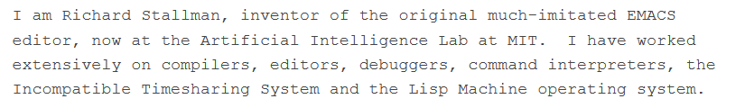
How does a FLOSS project start?
A free software project emerges
When there is a need to solve a problem ??
With the ability to find a solution.
At least the knowledge to start
Richard Stallman GNU
When a simple, well designed partial solution exists in a form
To be shared to draw the attention of others
who have the same problem and
who may be interested in the solution.

Slide 4
How does a FLOSS project start?
Small problems => unexpected innovations
Linux => GNU/Linux
took years to exert its transforming effect.
Python project started in 1990
When the users of a product participate as co-developers
high speed
Good quality
new features
unexpected innovations come after attacking small problems

Slide 5
How does a FLOSS project start?
Initial source code
becomes the seed
A community
Attracted by the code itself
Simple, well designed, well written
Attracted by the authors
Attracted by the problem domain
Attracted by the coding platform
Attracted by the hosting platform
Policies and rules
Code of conduct
Contribution guidelines
The hosting platform
a source code repository (version control system),
public forum facilities, and
project web pages.

Slide 6
FLOSS users or developers
The FLOSS paradigm revolves around
how code is distributed and consumed.
licenses
how code is produced.
Collaborative/participatory
Commons based
Foundation backed
Corporate Sponsored

Slide 7
Developer Motivation
Intrinsic Motivation
Coding is fun.
Extrinsic Motivation
Money?
not the main driver.
open source substitutes cooperation for financial transactions
Reputation
Job prospects
Cooperation
Psychological, social needs

Slide 8
Q: Are you convinced? Ans: Yes, no

Slide 9
Management and Coordination
Self coordination
80% of activities by a small number of individuals
core-periphery structure
Highly technical and Managerial tasks by core
Less technical and Supporting tasks e.g. bug fixing by periphery
Community dynamics
Developer turnover
Developer progression

Slide 10
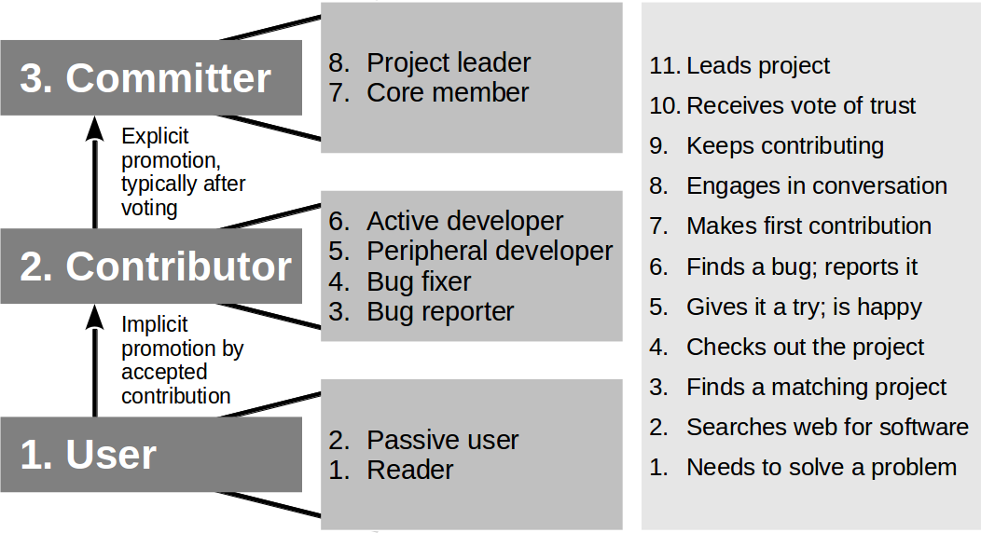
The onion model
A road map for developers’ progression in open source projects
Fig. source Dirk Riehle. “How Open Source is Changing the Software Developer’s Career.” IEEE Computer vol. 48, no. 5 (May 2015). Page 51-57..

Slide 11
Who is what in a FLOSS community?
User - who directly use the code
Author - project creater who creates the initial code
Maintainer - project curator who changes/updates the code
Committer -
Contributor, Developer - Writing code, documentation
Active contributors (also called “regular contributors” or “long-term contributors”)
casual contributors or “one-time contributors,

Slide 12
Community Dynamics:
User may leave if they don’t get what they are looking for
Author may also leave at some point of team
Handover the project to someone
Interested
user
Developers join a project due to motivation
when individual motivation declines members might leave, but they are replaced by new, eager faces.
Maintainers
They might cite feelings of obligation, community, or helping others as reasons for looking after the project.
For solo maintainers, however, when their motivation declines the decision to leave can have serious consequences for the project.
After a maintainer leaves, another developer might step up.
A lesser-known developer may be eager for an opportunity to maintain a popular project.
maintainers may eventually step down, find a replacement, or disappear altogether.
Join and Leave!!!

Slide 13
A good FLOSS product has ………
the conditions of innovation:
open standards and protocols
to connect other software
good documentation,
a well-defined extension mechanism
that allows people to "roll their own"
licenses to allow others to extend without getting permission.
Last but not the least, an active community

Slide 14
Past success stories
According to Linus Torvalds,
Linux succeeded partly due to good design principles which paved the way for easy extensions in the future.
Similarly, Larry Wall tells
Perl’s feature-set evolved naturally as per needs of its users.
A modular architecture
allows users to extend the system's functionality without having to change existing core functionality.
Which further allows the project to scale with its community and also allows the authors to retain control over the core product.

Slide 15
What can you contribute?
No contribution is small!!
Great things happen with small contributions from people with different skills
Coding skills
Fixing bugs
New features/enhancement
Code improvements
Language skills
Documentation
Fixing typos
Translation in different languages
Writing tutorials, how-to-pages, newsletters

Slide 16
Open source is not only about software
Several types of projects
Education
Curriculum
Books
Tutorials
Courses
Research
https://github.com/jeanqasaur/women-in-programming-languages-research
Lists
https://github.com/public-apis/public-apis
https://github.com/sindresorhus/awesome
https://github.com/h5bp/Front-end-Developer-Interview-Questions

Slide 17
Contributing to an OSS project
Technical Contributions
code
Documentation
Discussions
Reviews
issues
Non technical contributions
like organizing events
providing financial support

Slide 18
Commercial vs FLOSS
Commercial product development focus on creating products for profit.
There are many products that meet real needs that are either too specialized or too early to market to produce the return on investment that either a large company or a venture-backed startup demands.
In fact, many open-source projects have been started to solve a user's particular problem.
The return on investment is the solution to the problem.
But what the early open-source developers realized was that by giving away their work to the networked community of like-minded developers, they might get an additional dividend of functionality returned by other users of the product.

Slide 19
Developers use version control to track and synchronize their changes,
multiple people often strangers
Sharing work artefacts
different time zones
A version control system, such as Git, helps developers
Track changes
Resolve any differences
Coordinate tasks.

Slide 20
Using GitHub as the platform
Lowers barriers to contribute
on GitHub user interface every project has the same structure e.g. code, issues, pull requests, wiki
regardless of its language or function.
Each project has a landing page in the form of a README file.
A Code of Conduct policy to govern community behaviour.

Slide 21
Do you have GitHub account? Ans: Yes, No

Slide 22
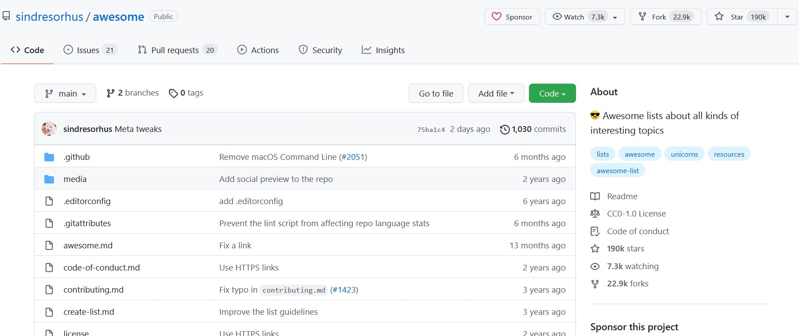
What does a FLOSS project look like
On the Github platform
Lets walk around
https://github.com/sindresorhus/awesome

Slide 23
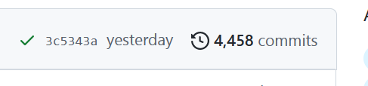

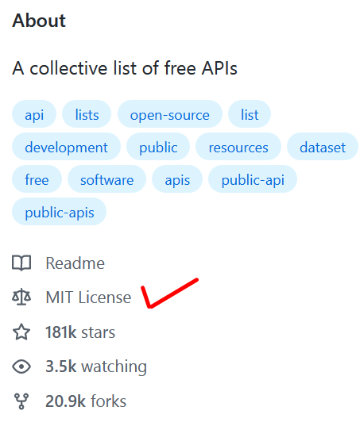
Technical aspects of contributing
Choose a project
License
Active or dead
date of the project’s last commit
Number of open issues
Number of open pull requests
Stable or not
Code of conduct
Community
Understand the project/codebase
Choose a task
Create an issue
Look for open issues
Set up the environment
Follow the style/guidelines
Make contributions

Slide 24
Social aspects of Contributing
Time
Interest
Skills
Patience
Respect for different cultures
Respect for others time
Let‘s be nice to each other!
Notes:
Skills – coding/non-coding, beginner/advanced, programming language

Slide 25
Choosing a task
Understand the project
Spend time and effort
Identify the task
online resources for beginners*
https://up-for-grabs.net/
https://goodfirstissue.dev/
https://www.firsttimersonly.com/
https://github.com/MunGell/awesome-for-beginners
*https://dev.to/pragativerma18/how-to-pick-an-open-source-project-to-contribute-to-4kak

Slide 26
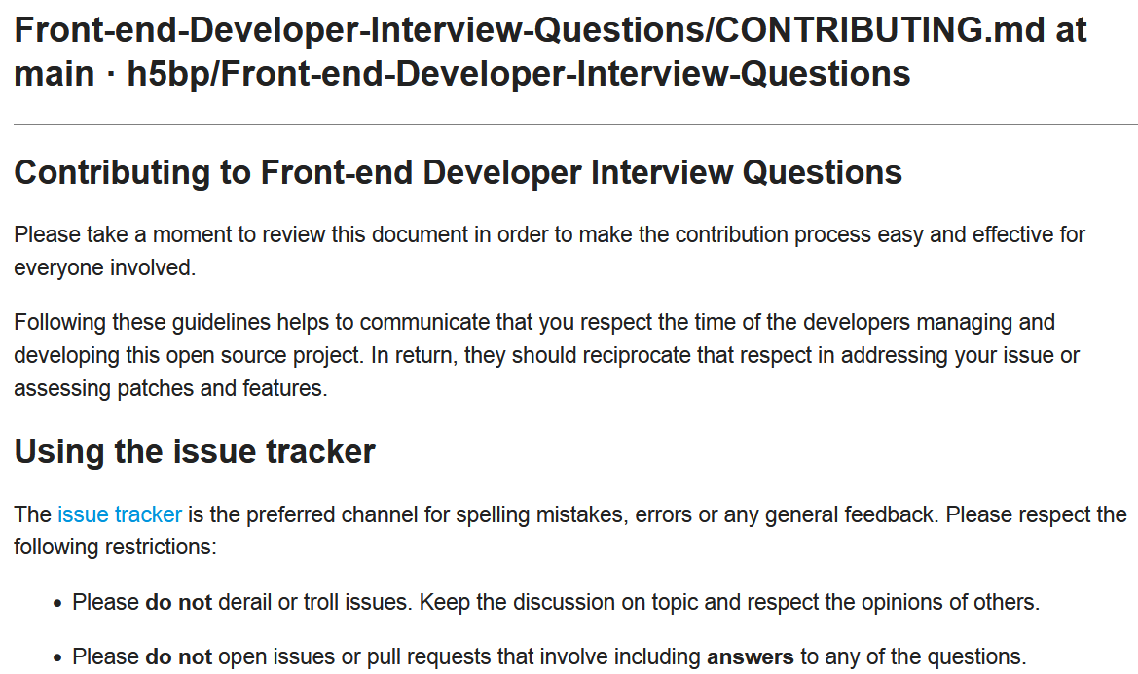
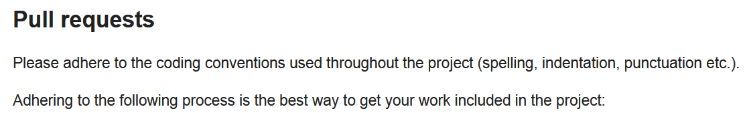
Contributor Guidelines
github.com /h5bp/Front-end-Developer-Interview-Questions/blob/main/.github/CONTRIBUTING.md

Slide 27
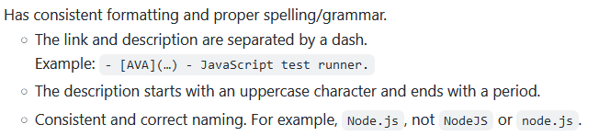
Follow a Coding/Writing Style
Style guide
to keep code/content clean and uniform
Easy to read and understand.
Code style as per the preferences of the project’s author.

Slide 28
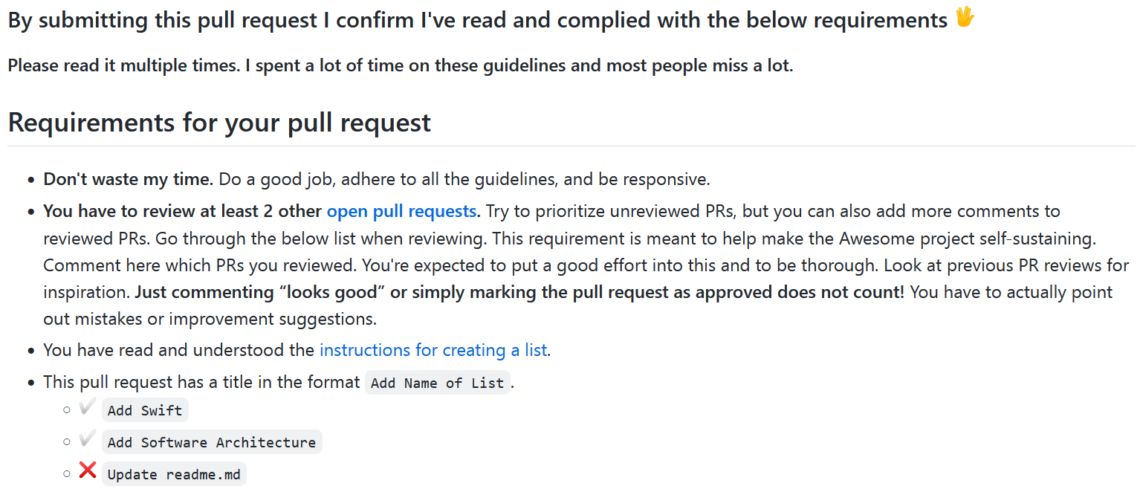
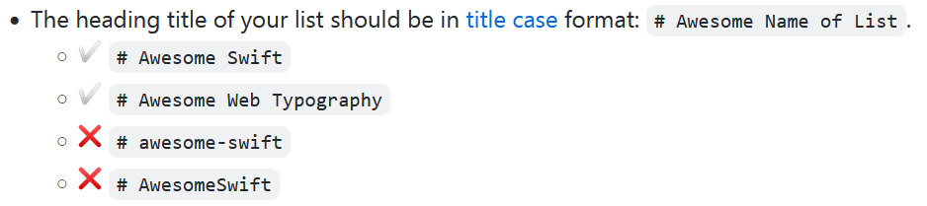
Follow a Coding/Writing Style
What looks better?
Gian or GIAN

Slide 29
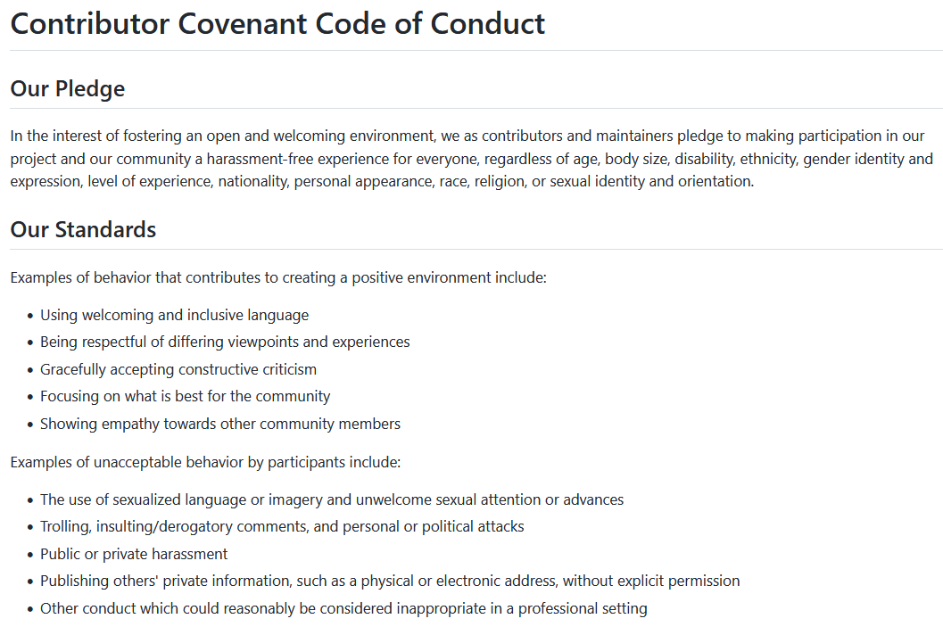
Positive
Negative
https://github.com/sindresorhus/awesome/blob/main/code-of-conduct.md

Slide 30
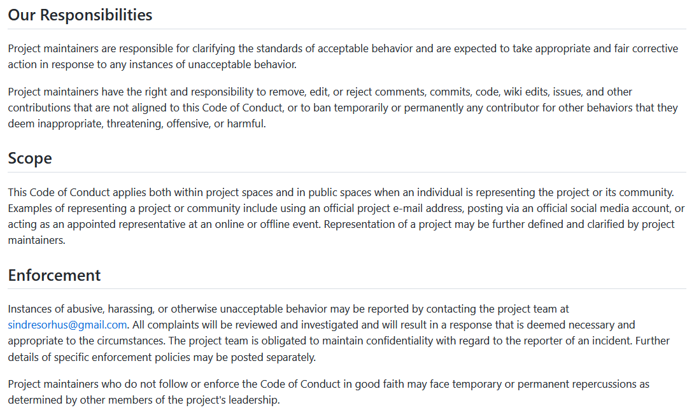

Slide 31
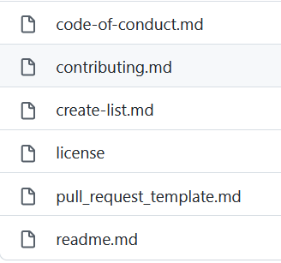
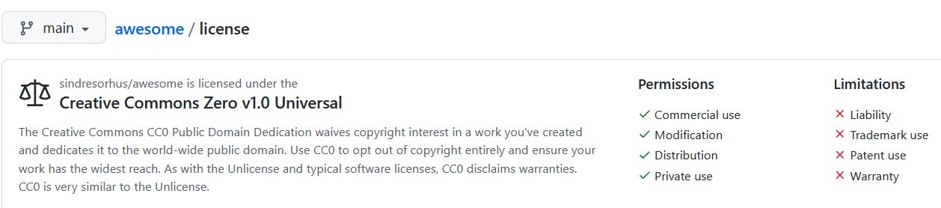
A checklist before you contribute*
When you’ve found a project you’d like to contribute to, do a quick scan to make sure that the project is suitable for accepting contributions. Otherwise, your hard work may never get a response.
Here’s a handy checklist to evaluate whether a project is good for new contributors.
1. Meets the definition of open source
Does it have a license?
Usually, there is a file called LICENSE in the root of the repository.
*https://opensource.guide/how-to-contribute/

Slide 32
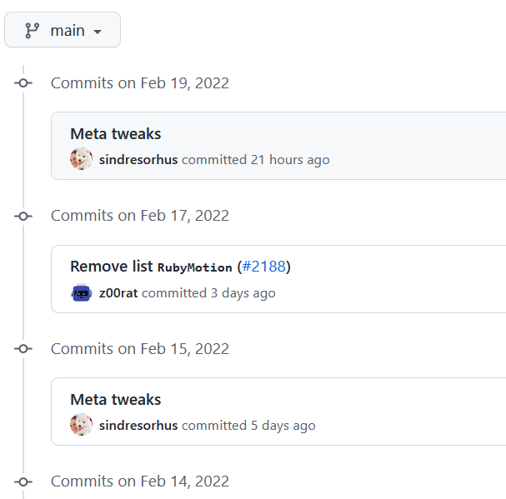
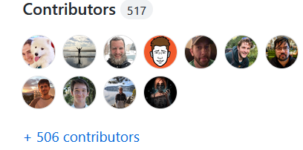
A checklist before you contribute
2. Project actively accepts contributions
Look at the commit activity on the main branch. On GitHub, you can see this information on a repository’s homepage.
2.1 When was the latest commit?
2.2 How many contributors does the project have?
2.3 How often do people commit? (On GitHub, you can find this by clicking "Commits" in the top bar.)
Lets walk around
https://github.com/sindresorhus/awesome

Slide 33
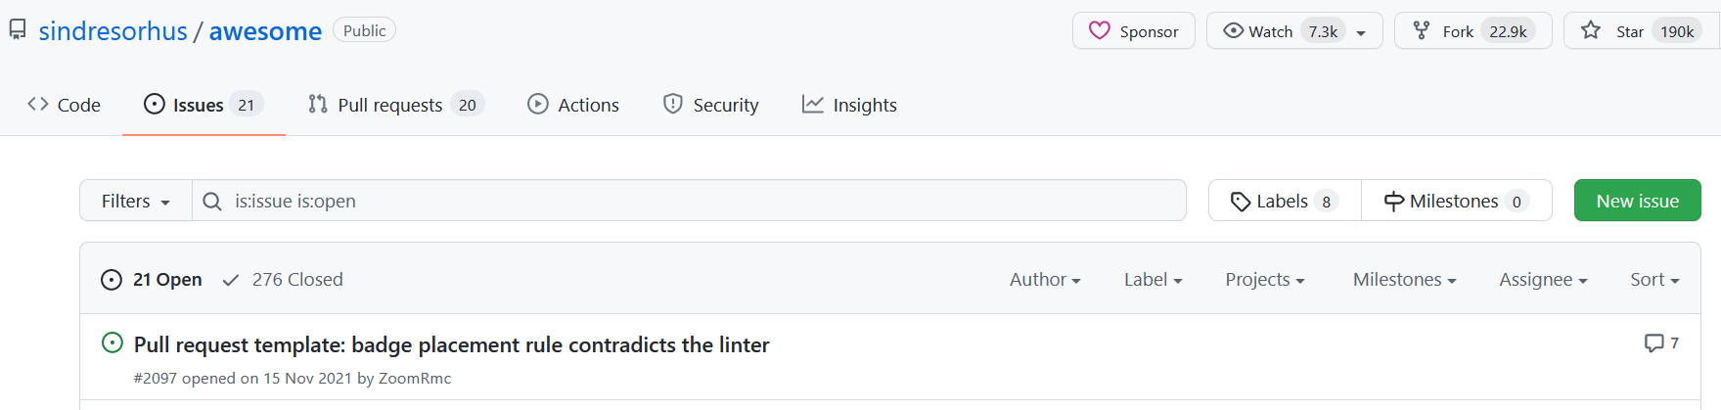
A checklist before you contribute
Next, look at the project’s issues.
2.4 How many open issues are there?
2.5 Do maintainers respond quickly to issues when they are opened?
2.6 Is there active discussion on the issues?
2.7 Are the issues recent?
2.8 Are issues getting closed? (On GitHub, click the "closed" tab on the Issues page to see closed issues.)

Slide 34
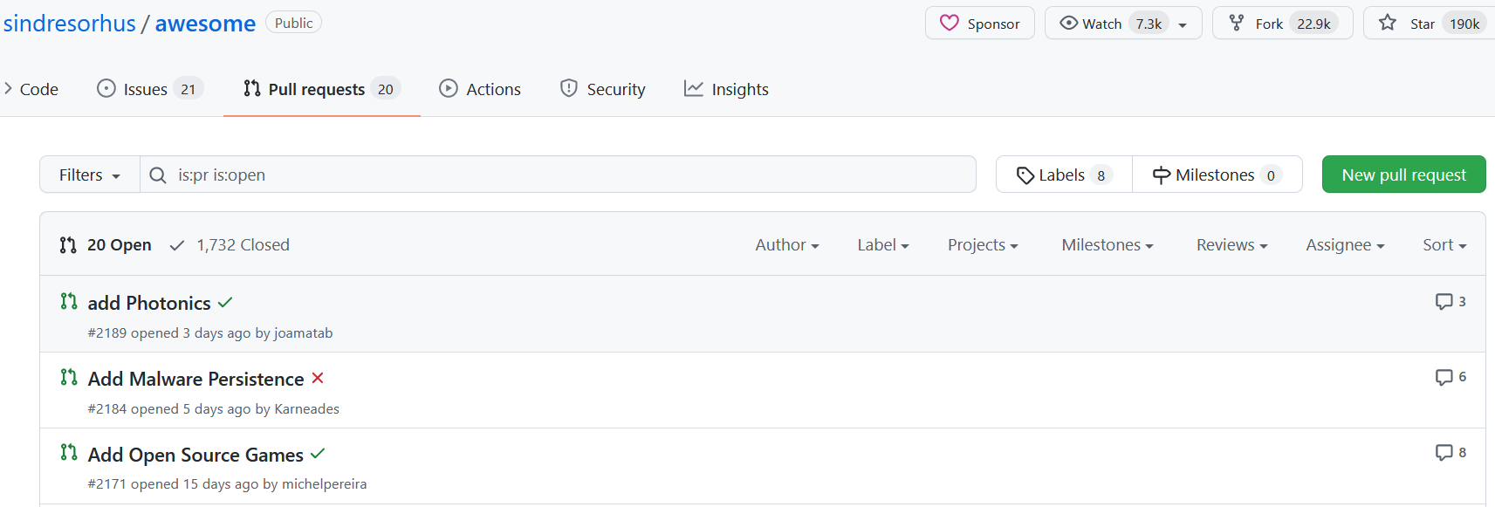
A checklist before you contribute
Now do the same for the project’s pull requests.
2.9 How many open pull requests are there?
2.10 Do maintainers respond quickly to pull requests when they are opened?
2.11 Is there active discussion on the pull requests?
2.12 Are the pull requests recent?
2.13 How recently were any pull requests merged? (On GitHub, click the "closed" tab on the Pull Requests page to see closed PRs.)

Slide 35
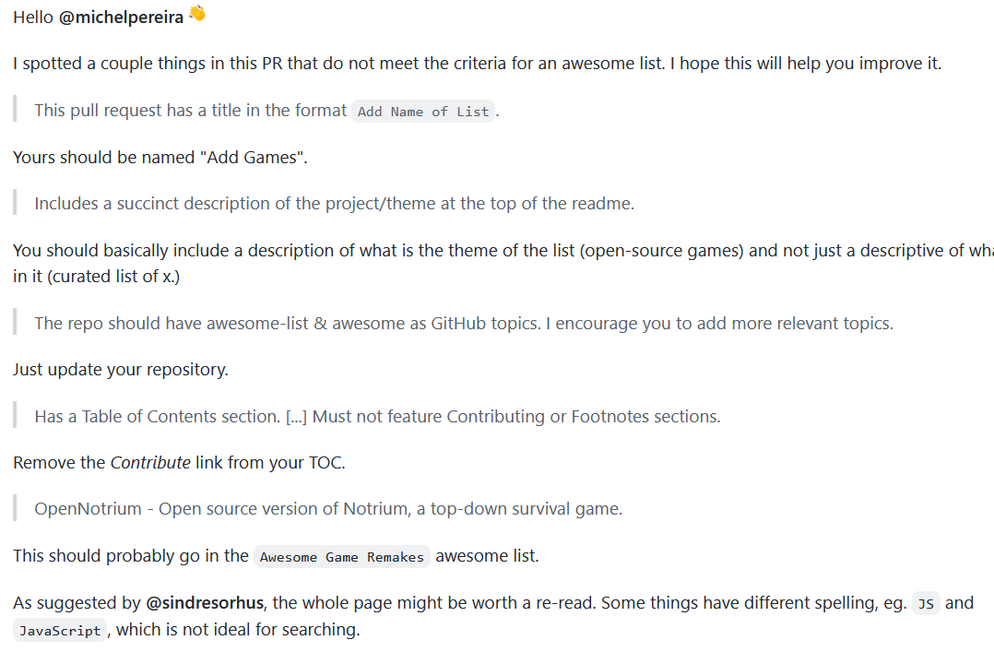
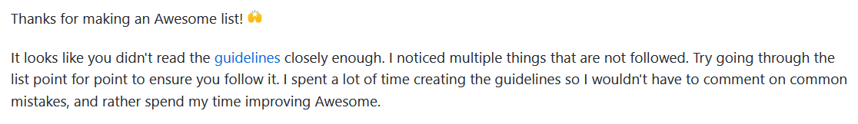
A checklist before you contribute
3. Project is welcoming
A project that is friendly and welcoming signals that they will be receptive to new contributors.
3.1 Do the maintainers respond helpfully to questions in issues?
3.2 Are people friendly in the issues, discussion forum, and chat (for example, IRC or Slack)?
3.3 Do pull requests get reviewed?
3.4 Do maintainers thank people for their contributions?

Slide 36
Don’t waste your time!!!
if you want to make a substantial contribution, open an issue to ask before working on it.
It’s helpful to watch the project for a while (on GitHub, you can click “Watch” to be notified of all conversations), and get to know community members, before doing work that might not get accepted.

Slide 37
Use Templates and checklists
Templates for issues and pull requests are like contact forms for customer support:
they help “prescreen” user requests and filter out noise.
Maintainers sometimes use checklists
to make sure that contributors have read and agreed to all their conditions before submitting a pull request.

Slide 38
On to the GitHub platform
Basic Developer Workflow
GitHub provides features for the basic developer workflow
Social network for programmers
Issue trackers to raise errors/problems/concerns/requests
pull requests to submit solutions/patches
A clean way to submit, review, and merge proposed contributions.
GitHub’s user interface is easy and intuitive.
Compared to the old setup of downloading tarballs to get code and surfing the mailing lists to discuss the issues

